Slide 1
Prediction of Employee Attrition
Name: Md. Shamsul Rahat Chy
ID: 21101180

Slide 2
Motivation for this Paper
Predicting attrition saves money on hiring and training.
Proactive prediction keeps work flowing smoothly.
Early turnover detection enables swift action to improve job satisfaction and stabilize the workplace.

Slide 3
What is Employee Attrition?
Employee attrition refers to the natural process of employees leaving an organization over time.
It includes voluntary departures, retirements, terminations.
Attrition impacts workforce stability, productivity, and organizational performance.

Slide 4
Related Work on Employee Attrition Prediction
(Early Prediction of Employee Attrition using Data Mining Techniques)
Research focuses on predicting and addressing employee turnover through data mining techniques.
Utilization of models like Logistic Regression, Support Vector Machine, and Neural Network for prediction.
Emphasis on the costs and operational impacts of attrition, highlighting the need for proactive retention strategies.
Paper link: https://ieeexplore.ieee.org/document/8692137

Slide 5
Data Analysis:
Dataset Description:
Information of total 1470 employees
Total 35 columns
Attributes include age, attrition, daily rate, job role, monthly income, etc.
Data Types
Numeric and categorical variables
Missing Values
None across all columns

Slide 6
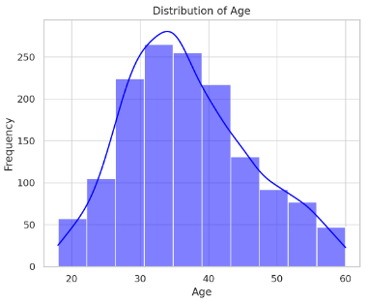
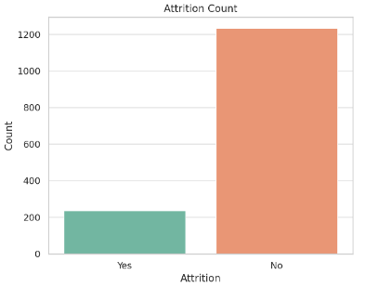
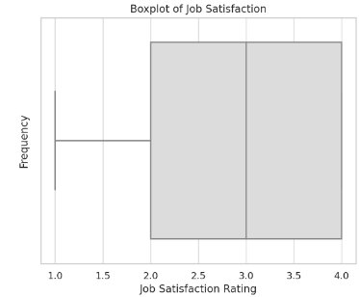
Overall Analytical Description:
The age of employees is fairly normally distributed, with a concentration around 30 to 40 years. This suggests a diverse age range in the workforce.
The majority of employees have not left the company ('No' on attrition), but there is a significant number who have ('Yes'), indicating employee turnover could be an area of concern.
The job satisfaction levels are mostly high (levels 3 and 4), indicating that most employees are satisfied with their job. However, there are still employees who report lower satisfaction (levels 1 and 2), which could be a potential area for improvement.
Distribution of Age Attrition Count Job Satisfaction

Slide 7
Methodology:
Data Preparation:
Initial Data Inspection: Checked for data types and missing values.
Feature Engineering:
Dropped Features: Employee Count, EmployeeNumber, Over 18, Standard Hours
Scaling and Normalization: Applied StandardScaler to numerical features to standardize data

Slide 8
Methodology:
Data Preparation:
Separate Features and Target: Isolate input features (X) and target variable (y).
Split Data: Divide dataset into training (70%) and testing (30%) subsets using stratified sampling.
Scale Features: Normalize features using StandardScaler to address varying scales.
Model Initialization and Training Initialize Models:
Begin with Logistic Regression, Random Forest, SVC, and XGBoost.
Fit Models on Training Data: Train each model on scaled training data.
Initial Model Evaluation: Assess performance using accuracy and ROC AUC scores on testing data.
Models Comparison and Evaluation Metrics
Models: Logistic Regression, Random Forest, SVC, XGBoost.
Evaluation Metrics: Accuracy, ROC AUC, F1 Score.

Slide 9
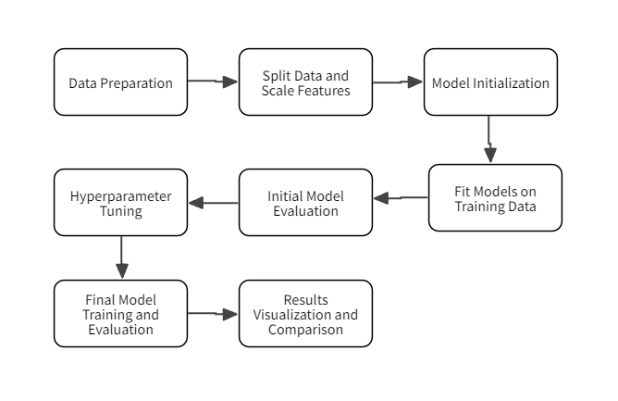
Methodology: Flowchart

Slide 10
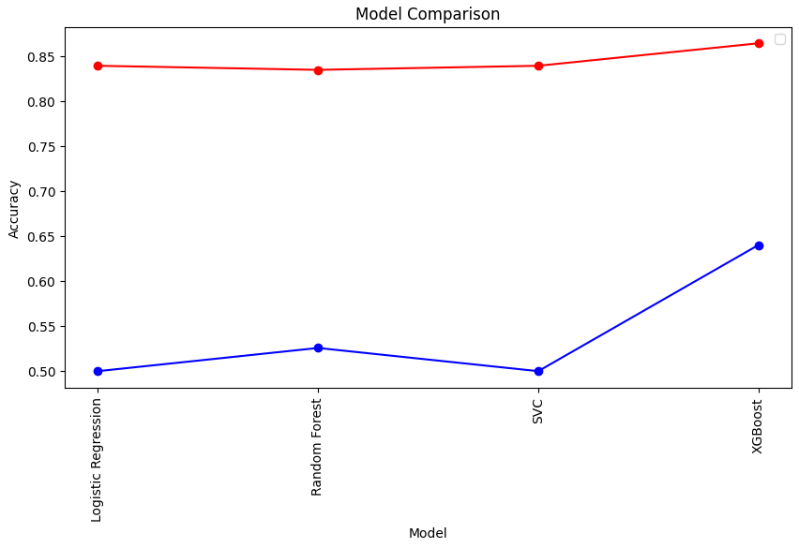
Evaluation:
Performance of Models:
(Logistic Regression and SVM)
Low ROC AUC and F1 Scores indicate challenges in managing precision-recall balance.
Random Forest:
Moderate success with Accuracy: 83.44% and F1 Score: 0.12

Slide 11
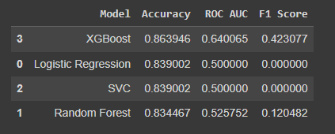
Evaluation:
XGBoost Performance:
Highest Accuracy: 86.93%
Highest ROC AUC: 0.64
Highest F1 Score: 0.42
Best model for handling the binary classification of predicting employee attrition.

Slide 12
Thank You

